Slide 1

A Watershed’s Role in AIS:
From Committee Concepts to
Rapid Response
November 30, 2018
Laura Jester
Bassett Creek Watershed Management Commission Administrator
Meg Rattei
Karen Chandler
Barr Engineering Co.

Slide 2
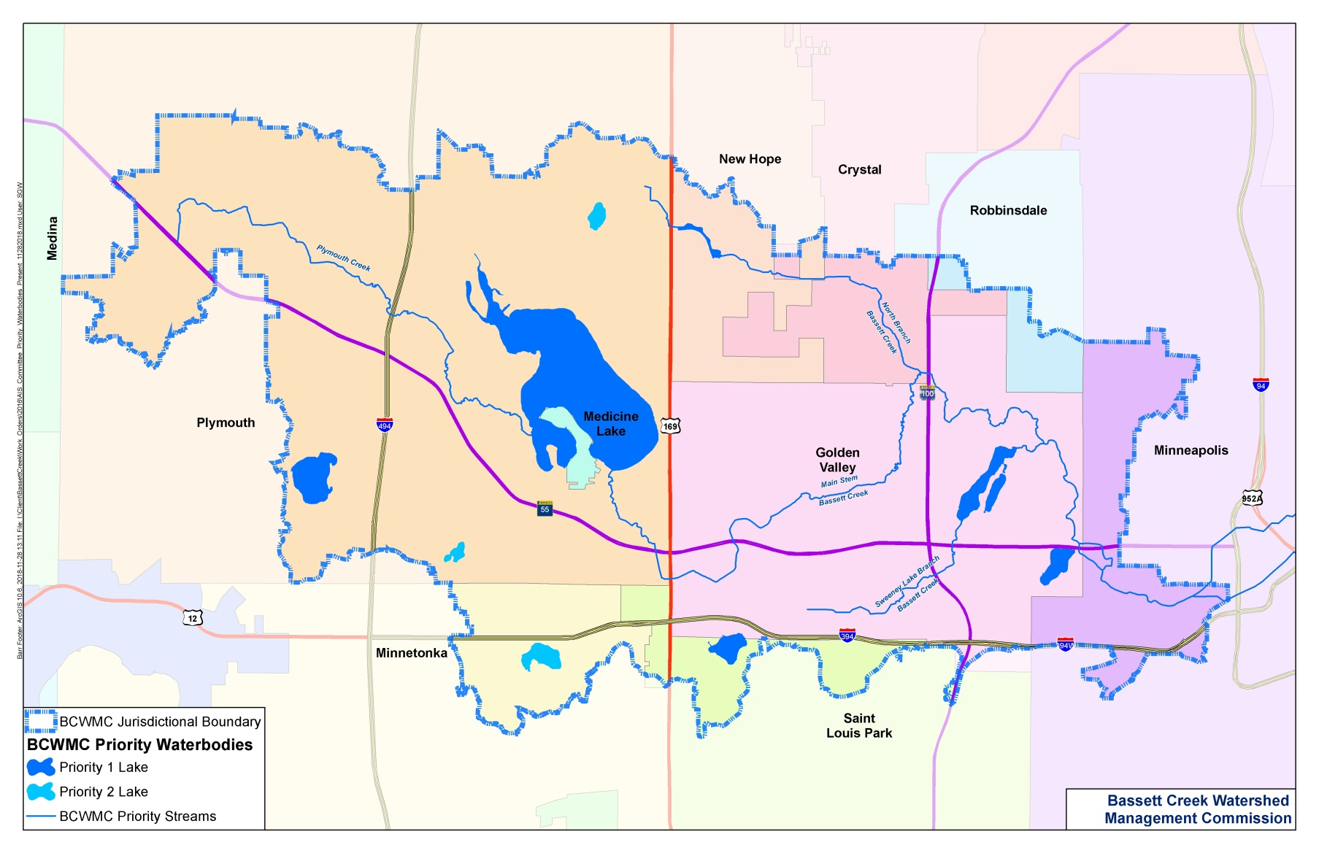

Bassett Creek Watershed
Notes:
Priority 1 Lakes:
Medicine,
Northwood,
Parkers,
Sweeney,
Twin &
Wirth Lakes

Slide 3




Presentation Overview
AIS problem and committee concepts
Process and framework for
developing AIS role
Rapid Response Plan for
BCWMC’s priority lakes
Rapid Response Plan for key AIS:
zebra mussels, starry stonewort, and
Eurasian watermilfoil
Notes:
Priority 1 Lakes:
Medicine,
Northwood,
Parkers,
Sweeney,
Twin &
Wirth Lakes

Slide 4
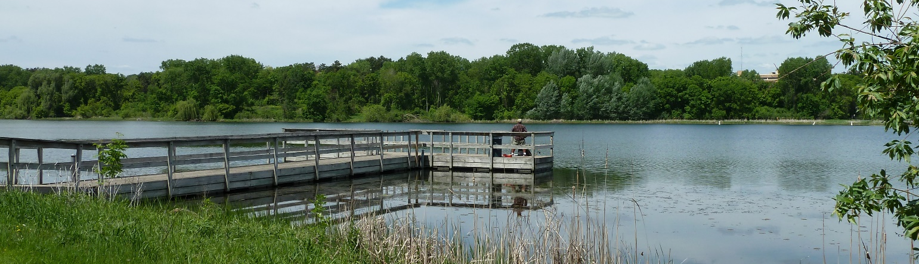
Problem
Widespread concern about AIS
Multiple stakeholders involved in addressing AIS
Unclear role for BCWMC in AIS issues

Slide 5
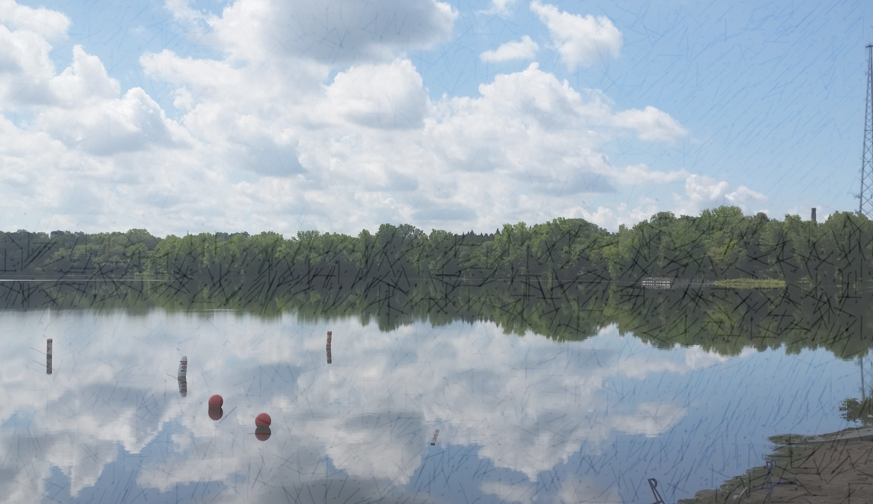
Created APM/AIS Committee
Included BCWMC Commissioners and staff, city staff, representatives from lake groups, Three Rivers Park District, Minneapolis Park and Rec Board, Hennepin County, DNR, Met Council
Met 8 times (June 2016 – June 2017)
Reviewed current status of AIS:
  Where is AIS and how is it transported?
  Who is doing what right now?

Slide 6
BCWMC APM/AIS Committee Concepts
PRIMARY PROJECT OBJECTIVE | BCWMC should be involved | BCWMC should partner | No BCWMC role
Improve water quality | X
Improve habitat and the overall ecology of the waterbody | X
Protect the function or capacity of flood control project | X
Improve recreation |  | X
Improve or protect human health and safety |  | X
Improve aesthetics |  |  | X

Slide 7
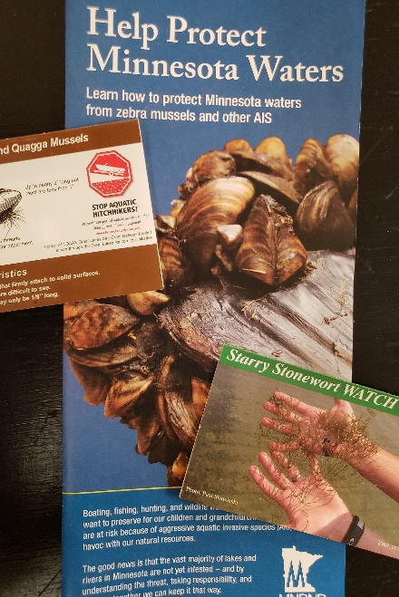
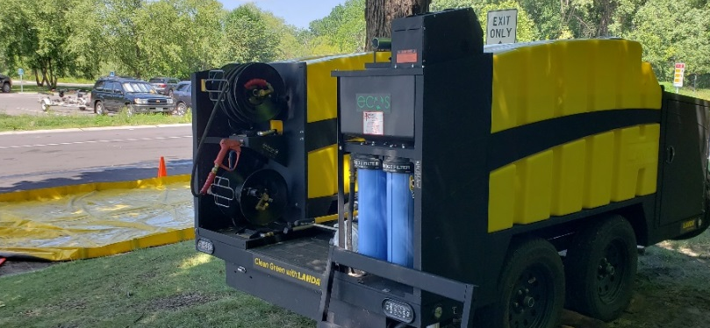
Committee Concepts: Recommendations on Prevention
Early detection
Rapid response**
Education
Inventories, studies,
and monitoring
Access management
Partnerships!!

Slide 8
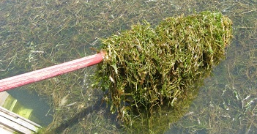
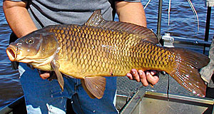
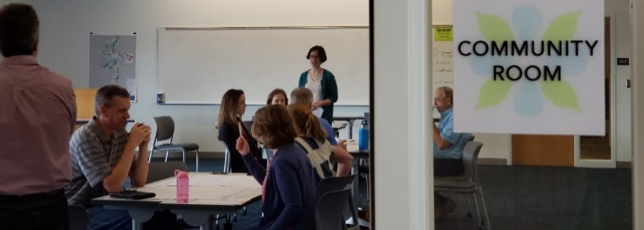
Committee Concepts: Recommendations on Management
Herbicide treatments
  Funding partner
  Approved mgmt plan to improve WQ or habitat
Carp management
Water-level management
Biological treatments
Convening lake groups
  Lake Leaders Workshop Oct 2018

Slide 9


AIS Rapid Response Plan
Commission approved APM/AIS committee recommendation to develop AIS Rapid Response Plan for key species in Priority 1 lakes
BCWMC engineer prepared AIS Rapid Response Plan
February 2018—Commission approved AIS Rapid Response Plan
Notes:
Draft approved at January meeting. After revisions, the final version was approved at the February meeting.

Slide 10
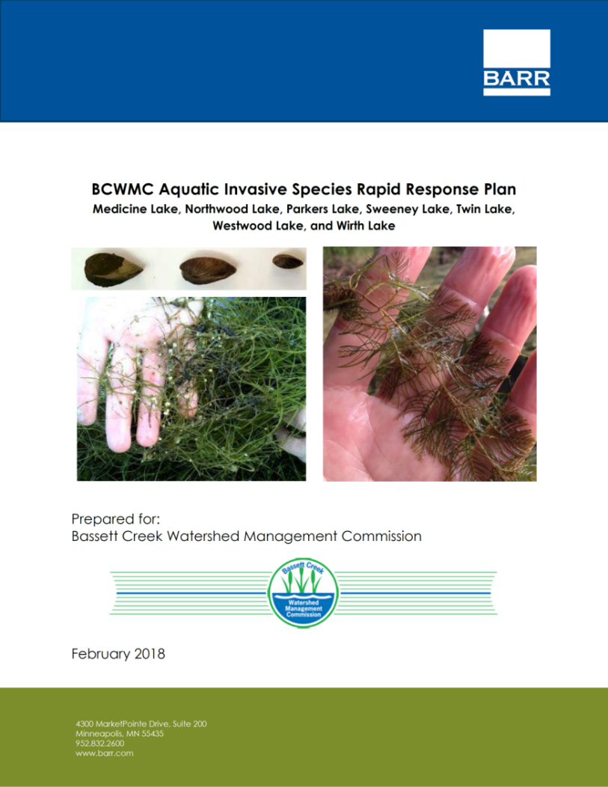



AIS Rapid Response Plan Process
Establish framework
Meet with partners
Prepare report
Notes:
The AIS rapid response plan process began with establishing the framework. The framework outlines the actions required to contain, and if possible, to eradicate newly introduced AIS. The framework guides the response for all newly detected AIS.
Partner meetings were held to determine roles and responsibilities of the partners working to contain the newly detected AIS. After the framework was established and the roles and responsibilities of the partners determined, the AIS Rapid Response Plan was prepared.

Slide 11
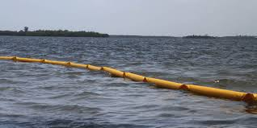
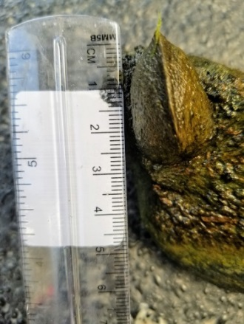
AIS Rapid Response Plan Framework
Report AIS to DNR
Communicate AIS infestation to stakeholders, lake groups, and public
Monitor to define extent of AIS
Isolate AIS infestation if necessary
Collaborate with partners regarding treatment/removal and cost
Obtain DNR permit
Notes:
The RR Plan Framework consists of 12 actions.

Slide 12
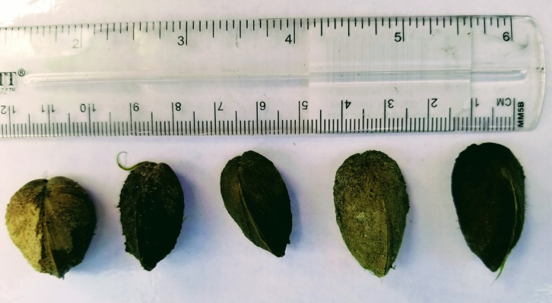
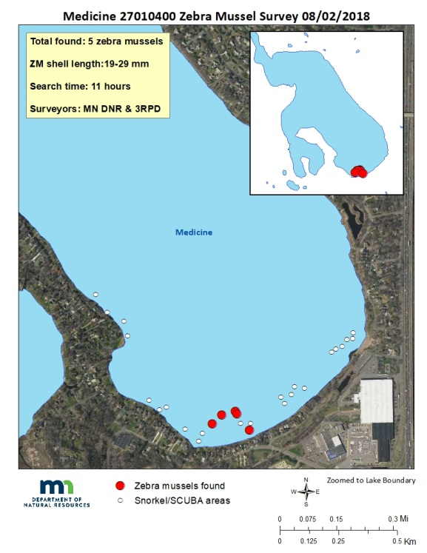
AIS Rapid Response Plan Framework
Complete additional pretreatment monitoring, if necessary
Hire contractor and complete treatment/removal
Fund AIS treatment/removal
Complete post-treatment monitoring to determine effectiveness
Communicate treatment/
removal results
Design and implement education program

Slide 13







Meetings to Decide Partner Roles
5 member cities
Notes:
Minnesota Aquatic Invasive Species Research Center (MAISRC),

Slide 14


Rapid Response Plan for Northwood Lake
Partner Role
Activity
12 activities
BCWMC
City of New Hope
Hennepin County
MDNR
MAISRC
Notes:
The partner role for each of the 12 activities is shown on the plan. Hand out the plan for Northwood. Briefly say that the 12 activities shown previously are detailed in the activity column. Each of the partners are listed and the role they will play for each of the 12 activities is shown on the plan.

Slide 15



Varied BCWMC Roles
Takes the lead—completes most of the work, funds all or most of the project, and collaborates with others
Takes the lead and helps fund larger projects; collaborates on smaller projects
Provides technical guidance
Acts as funding partner
Notes:
For individual lakes, BCWMC role depends on the roles desired by partnering entities & varies between lakes.

Slide 16
BCWMC Rapid Response Plan for Key AIS species
Eurasian watermilfoil—present in Medicine Lake, Parkers Lake, and Wirth Lake but not in the remaining four Priority 1 lakes
Starry stonewort—present in Medicine Lake but not in the remaining six Priority 1 lakes
Zebra mussels—present in Medicine Lake but not in the remaining six Priority 1 lakes
Notes:
For each key species, the AIS rapid response plan provides a step-by-step response that includes such details as the type of survey that is needed to define the extent of the infestation, when the MnDNR would or would not permit treatment, types of treatment to address the infestation, and information about follow up monitoring to determine results.

Slide 17
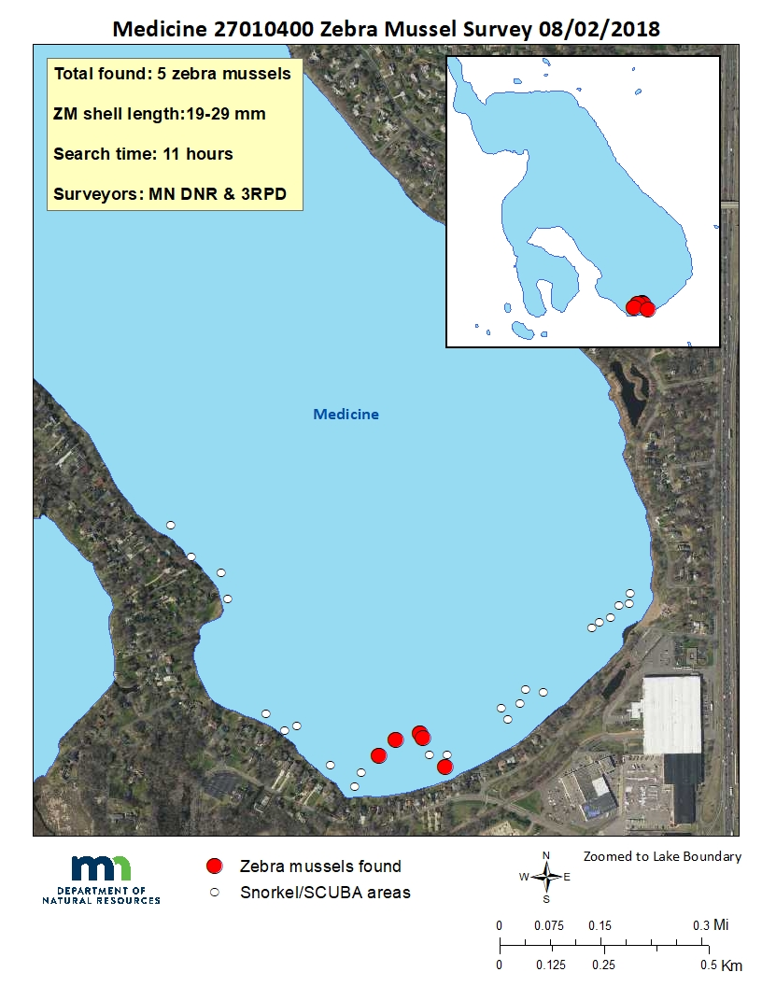
Rapid Response to Zebra Mussels
Define extent – meandering survey (wading, scuba)
Map infested area
Apply for DNR Permit
Isolate and treat with Earthtech QZ
Determine results per survey methods in permit
Eurasian watermilfoil
Notes:
DNR only allows treatment under its pilot program if infestation is small enough to be isolated and DNR determines the infestation is new enough that no reproduction has likely occurred. If DNR believes the population has reproduced, no treatment will be allowed. Map Credit = DNR. MAISRC is currently working on a project to determine a survey method to accurately quantify zebra mussels. The DNR will specify the post-treatment survey method in the permit. The DNR may use the MAISRC methodology when the project has been completed. For Medicine Lake, no treatment was allowed because the DNR concluded the zebra mussels had reproduced (different sizes and found in several locations)

Slide 18
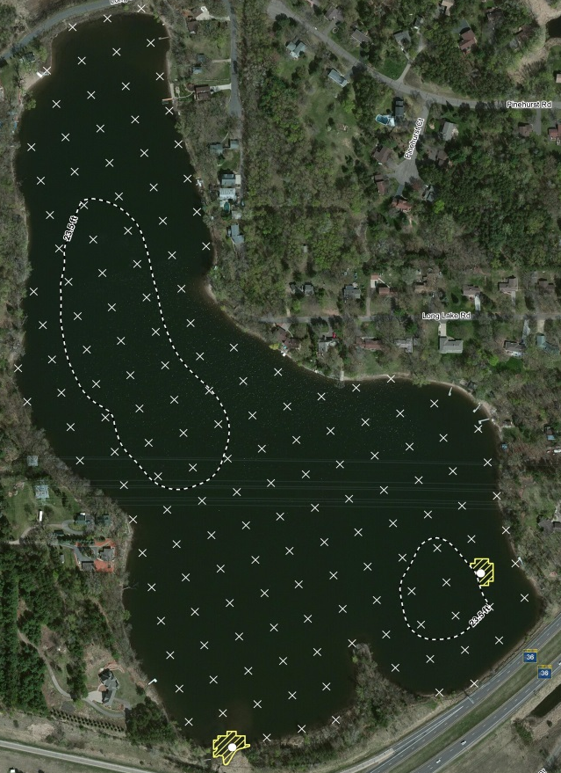
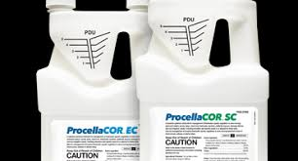
Rapid Response to EWM
Define extent - whole lake point intercept survey
Map treatment area
Apply for DNR Permit
Treat with Procellacor
Determine results - whole lake point intercept survey
Eurasian watermilfoil
Notes:
DNR permit easily obtained as long as treatment area is <15% of littoral area.
Procellacor is a new chemical that shows some promise.

Slide 19
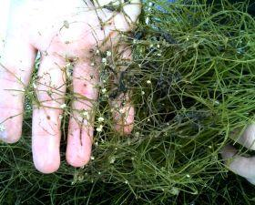
Rapid Response to Starry Stonewort
Define extent - whole lake point intercept survey
Map treatment area
Apply for DNR Permit
Treat with copper algaecide + additive (endothall, diquat)
Determine results - whole lake point intercept survey & sediment samples to determine bulbil density
Eurasian watermilfoil
Notes:
If DNR believes the infestation is small enough, the DNR committee will decide to permit a treatment. Treat with two different chemicals – a copper algaecide plus one additional chemical such as endothall or diquat. The synergism between the two chemicals increases effectiveness.

Slide 20
Rapid Response Example: Starry Stonewort in Medicine Lake
TRPD watercraft inspector found starry stonewort in July 2018 and notified DNR
TRPD immediately increased watercraft inspection hours
DNR/TRPD determined extent
DNR permitted and funded 4 chemical treatments in Aug-Sep
Post-treatment monitoring indicates reduced extent and density, but still present
Eurasian watermilfoil
Notes:
TRPD watercraft inspector saw starry stonewort on a fishing boat leaving the lake on 7/29. TRPD reported to DNR.
Kudos to TRPD and DNR for getting things done quickly and effectively. 15 acres treated with copper algaecide + Hydrothol 191 (endothall). Post-treatment surveys about 8 to 15 days after each treatment.

Slide 21
Starry Stonewort
Medicine Lake - first metro lake with Starry Stonewort
First observed in Lake Koronis (Stearns County ) in 2015
Currently found in 13 MN lakes
Once it is in a lake, difficult to eradicate – bulbils covered by sediment not impacted by treatment chemicals – no contact with chemical
Treatment permitted only for small infestations
Notes:
By County: Beltrami – 5 lakes, Stearns – 3 lakes, Wright – 2 lakes (West Lake Sylvia and Pleasant) other counties, 1 lake each – Hennepin (Medicine), Pope (Minnewaska), Itasca/Cass (Winnibigoshish). 5 Beltrami lakes – Turtle, Cass, Upper Red, Moose, and Wolf
3 Stearns Lakes – Grand, Koronis (includes Mud), and Rice

Slide 22
Benefits of Rapid Response to AIS
Maximizes efforts to contain/eradicate infestation – hit the ground running
Chemical treatment of zebra mussels and starry stonewort allowed only if very small infested area—timeliness is essential
May prevent establishment of AIS
May minimize ecological and economic impacts
1
2
3
4
Notes:
Benefit of the AIS Rapid Response Plan – can hit the ground running when a new AIS is detected and not waste time figuring out who is doing what; Commission and its partners know their roles and responsibilities and can work together to address any new AIS that is detected.

Slide 23
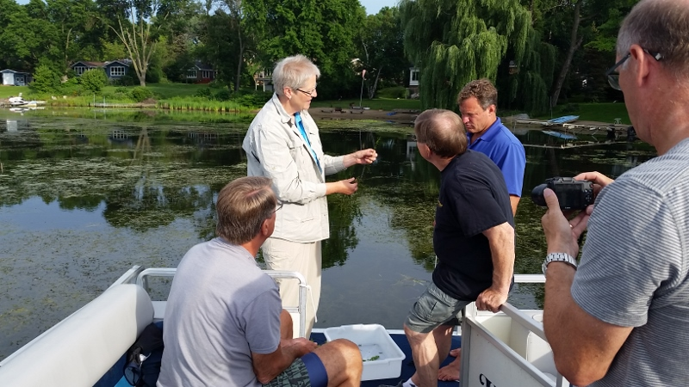
Lessons Learned
Rapid response is important, but early detection is key
Zebra mussels may not enter via public access
Starry stonewort grows rapidly and could be confused with a native plant
Need more robust monitoring (e.g., volunteers) and coordination
Photo: Fortin Consulting

Slide 24


Questions?
Web Link to AIS Rapid Response Plan:
http://www.bassettcreekwmo.org/application/files/9315/3962/9769/Final_BCWMC_AIS_Rapid_Response_Plan.pdf
Contact Information:
laura.jester@keystonewaters.com
MRattei@barr.com
KChandler@barr.com

